Slide 1
orange
the color of happiness

Slide 2
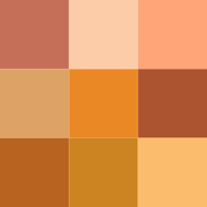
Color chemistry
Orange (color wheel)
Color coordinates
Hex triplet | #FF7F00
sRGB^{B} (r, g, b) | (255, 127, 0)
CMYK^{H} (c, m, y, k) | (0, 50, 100, 0)
HSV (h, s, v) | (30°, 100%, 100%)
Source | HTML Color Chart @30
B: Normalized to [0–255] (byte) H: Normalized to [0–100] (hundred)
Orange
Wavelength | 585–620 nm
Color coordinates
Hex triplet | #FF7F00
sRGB^{B} (r, g, b) | (255, 127, 0)
CMYK^{H} (c, m, y, k) | (0, 50, 100, 0)
HSV (h, s, v) | (30°, 100%, 100%)
Source | HTML Color Chart @30
B: Normalized to [0–255] (byte) H: Normalized to [0–100] (hundred)

Slide 3
Orange names and colors
[hide]v t e Shades of orange
Amber | Apricot | Atomic tangerine | Bittersweet | Brown | Burnt orange | Carrot orange | Champagne | Coral | Coffee
Dark salmon | Deep carrot orange | ECE/SAE Amber | Flame | Gamboge | Gold | Gold (metallic) | International orange | Lion | Mahogany
Mango | Marigold | Old gold | Orange | Orange (web) | Orange-red | Orange peel | Papaya whip | Peach | Peach-orange
Peach-yellow | Persian orange | Persimmon | Portland Orange | Princeton orange | Pumpkin | Rust | Safety orange | Salmon | Satin sheen gold
Sunset | Tangelo | Tangerine | Tawny | Tea rose | Tomato | Vermilion
A typical sample is shown for each name; a range of color-variations is commonly associated with each color-name.

Slide 4
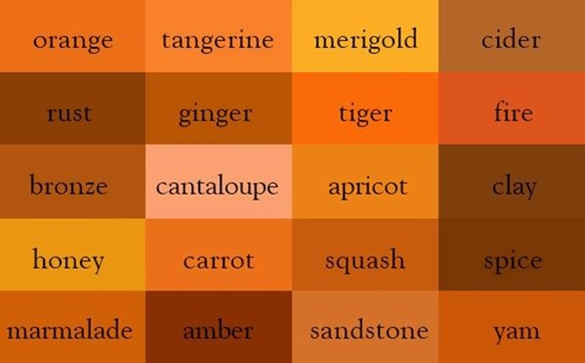
The many shades of orange

Slide 5
• The overall general meaning and psychological associations with the color.
The name Orange was taken from the fruit…which leads to the question.
“Which came first the color or the fruit.” -Will Brown

Slide 6
Often Associated with:

Slide 7
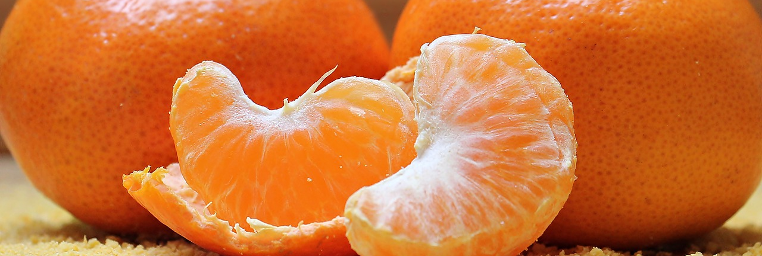
The Orange
A delicious and nutritious fruit.

Slide 8
Energy
Cheer
Vitality
Orange can create feelings of
Bad Taste
Danger
&
Saftey
illness

Slide 9
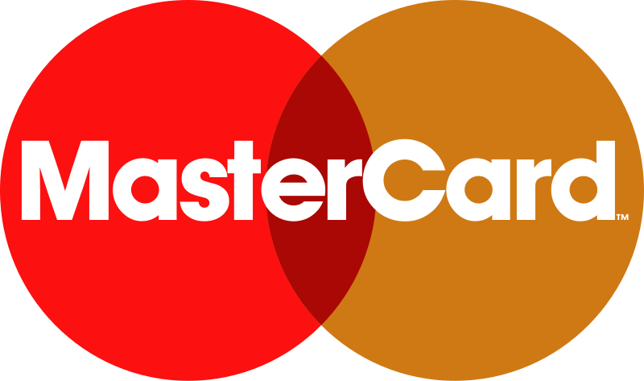
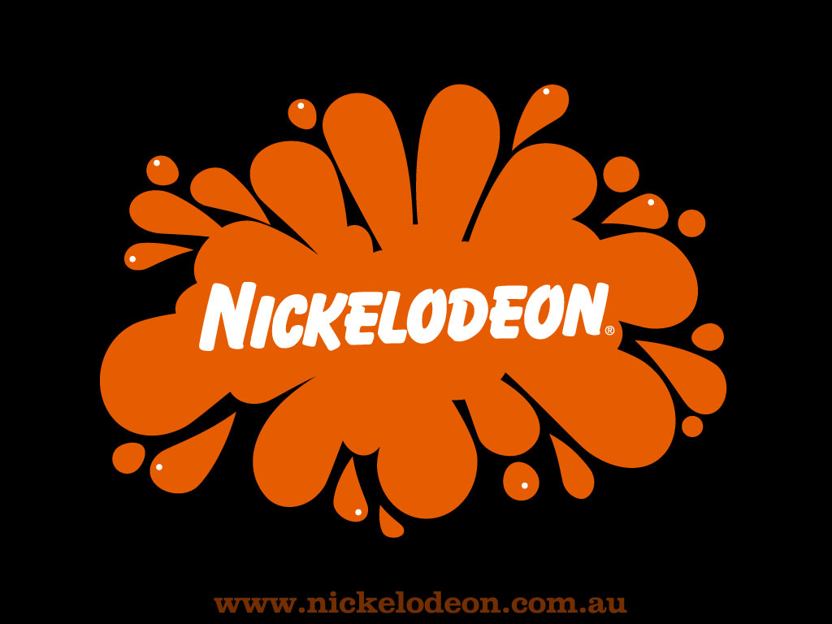
LOGOS’
Eye Catching
Positive
Energetic
Shopping
Financial
Entertainment
This Photo by Unknown Author is licensed under CC BY-SA
In many sectors of commerce, Advertising and entertainment.

Slide 10
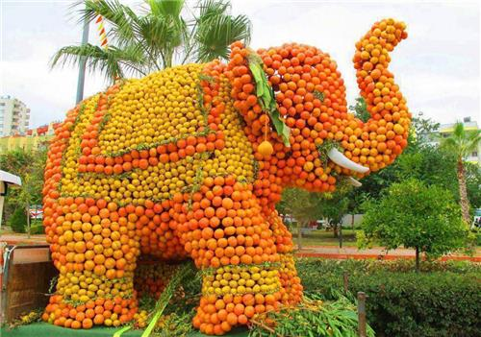
Many Cultural influences:
In ancient Egypt artists used an orange mineral pigment called Realgar for tomb paintings
In Ukraine in November–December 2004, it became the color of the Orange Revolution, a popular movement which carried activist and reformer Vikor Yushenko into the presidency.
In parts of the world, especially Northern Ireland the color is associated with the Orange Order, a Protestant fraternal organization and relatedly, Orangemen, marches and other social and political activities, with the color orange being associated with Protestantism similar to the Netherlands.
In Japan it denotes love and happiness and is a popular color in clothing. This vibrant color also denotes civilization and knowledge.

Slide 11
Websites in action:

Slide 12
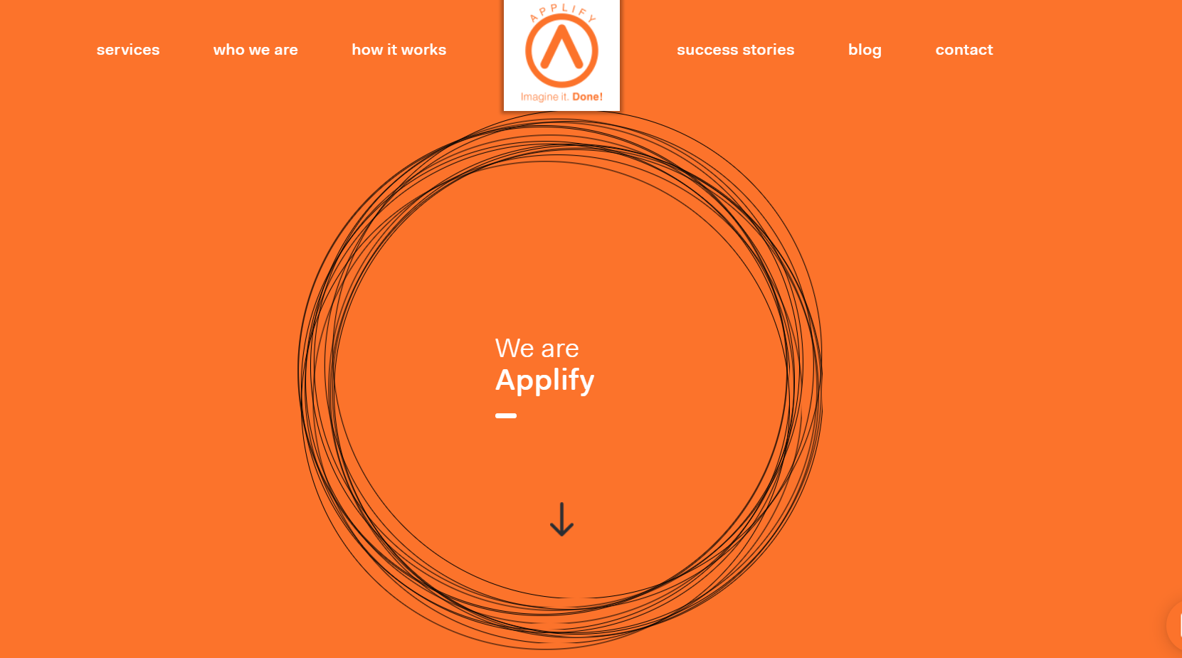

Slide 13


Slide 14


Slide 15
Bright
Engaging
Why do designers use this color:
Responsive
Energetic
Mood affecting
Current trend

Slide 16
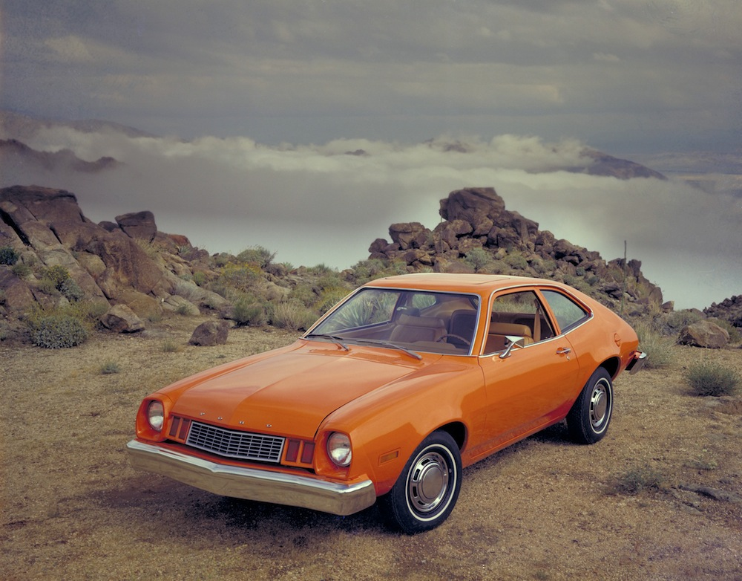
Family Photo:

Slide 17
THE END

